Slide 1
Account maintenance Pipeline Message flow
C157 & C163

Slide 2
Introduction
The purpose of this Presentation is to describe the message flow and processing of Account maintainace process via MQ message (C157 & C163).

Slide 3
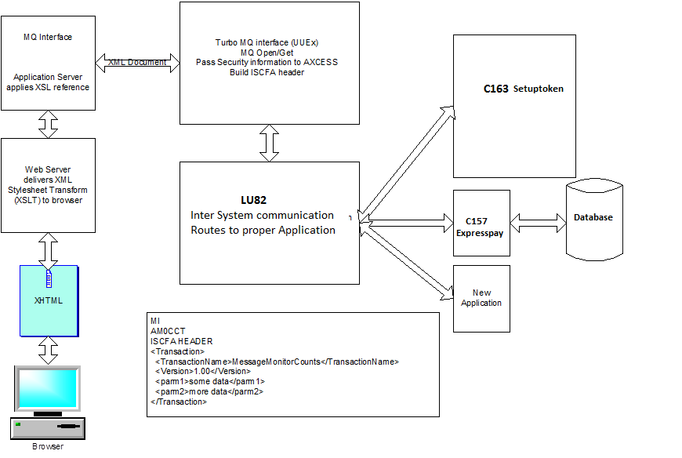
High level Message Flow

Slide 4
Description of message flow
Brower contacts Web Server with request
App Server attaches request to Security information and sends to MQ
MQ data received by TPF (UUEx) programs
Security data is validated
ISCFA Header is build from TP_Name and passed to LU81 for routing
LU82 recognizes TPNAME and passes control to respective processor

Slide 5
Actual program is given control
Program uses IBM XML Parser, or internal parsing to extract parameters
Program copies original ISCFA header, and appends new XML data.
ISCFA Processing for MQ reply removes ISCFA Header, retrieves MFH2 header and passes message back to original MQ requester.

Slide 6
Database Used in C157 &C163
CRCNAE – Key 60,45,70
CR21AE- Key D6,C3
CR81AE/CR86AE

Slide 7
Queries Please…..??
Thank You!!

